Slide 1
Blackjack Phase 2 -
Design
Nikolas Alvarado, Carolina Barbecho, Matthew, Santiago, and Brandon

Slide 2
Top 10 Requirements
System will follow standard Blackjack rules
Players will be able to play accordingly, and be paid accordingly based on the outcome of the game
System will define what a User may be able to do based on the Role linked with the account (Dealer, Player)
Depending on the role of the User, they will be shown different GUI options to interact with the program (Ability to hit, stand, draw cards, etc)
System must have a way to hold a set of “Tables” which contain a game, holding Users
User accounts will be pre-set with Dealer or Player roles linked to the accounts
Login and Logout features, Withdraw and Balance methods
Only dealers will be able to create “Tables” to host a game
Dealers are the only one who can decide whether or not to begin a game at a Table
Players must be able to leave and join Tables appropriately without disrupting a current game
A turn based system must be implemented to ensure no overlap
The current deck of cards should be reshuffled once a limit is reached to use a fresh deck

Slide 3
Top 5 class candidates
Account
The class in which a user can interact that does not involve an active game
Holds login information, role, and balance
Every account is preset with a role, cannot be changed
User
Class which will be used during the Blackjack game
Can be defined as a “Player” or “Dealer”
Can update personal balance outside of games
Linked to 1 Account object
Hand
The array of Card objects that user contains
Used by User to call game methods (Hit, Stand, etc.)
Deck
The array of Card used to draw cards
Lobby
The list in which it holds tables which hold separate games for players to join

Slide 4
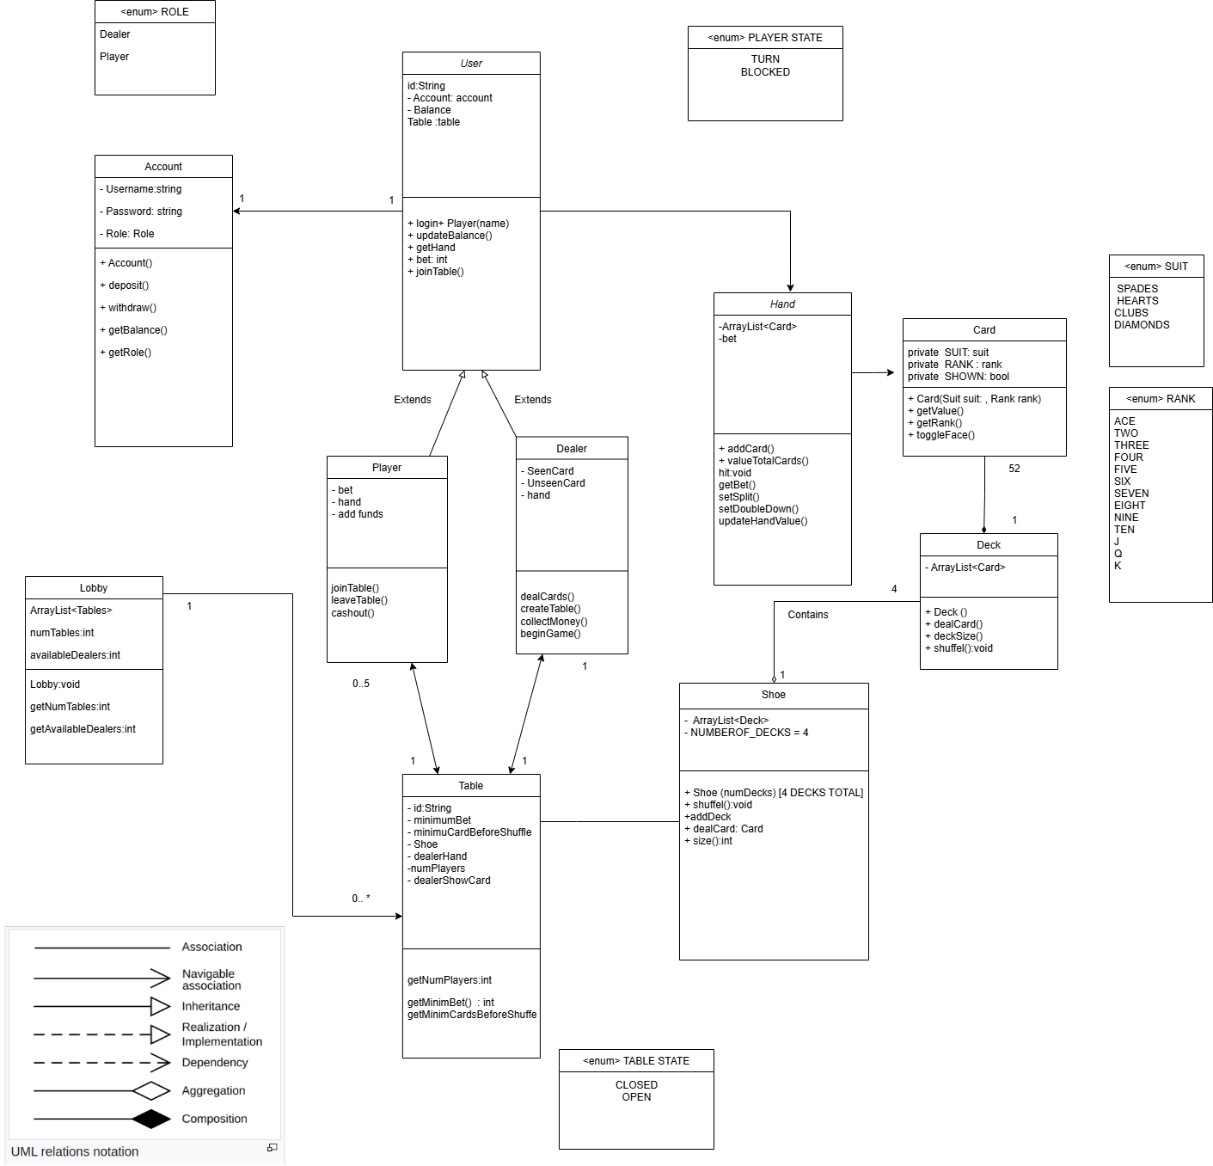
UML Class Diagram

Slide 5
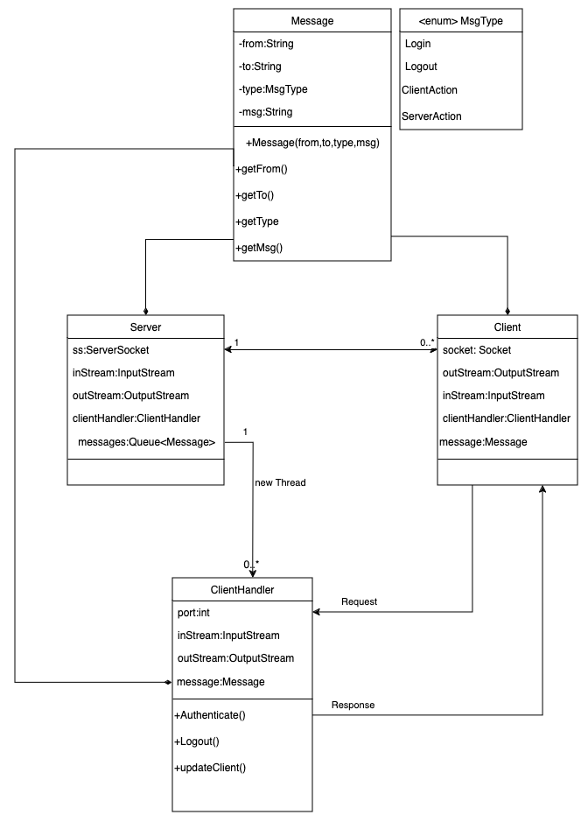

Slide 6
Main Use Cases for Blackjack
Account Login
To log into a premade account
Join Game
To select a table to join
Add Funds
To add fund towards the account’s bank
Withdraw Funds
To withdraw funds out of the account’s bank
Manage Hand
Used during your turn during a game
Leave Game
To leave a table
Deal Cards
To give participating users a card from the shoe
Create Table
To create a game to allow players to join
Start Table
To begin the game the dealer has created

Slide 7
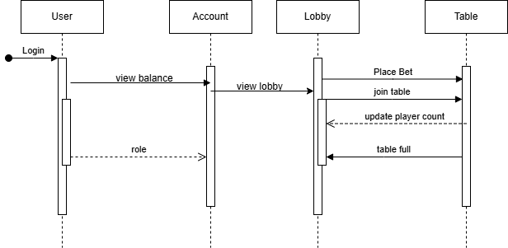
Sequence Diagrams of Use Cases:
Join Game
Notes:
Users log in. Players will select tables from lobby and they are going to input an amount to bet.

Slide 8
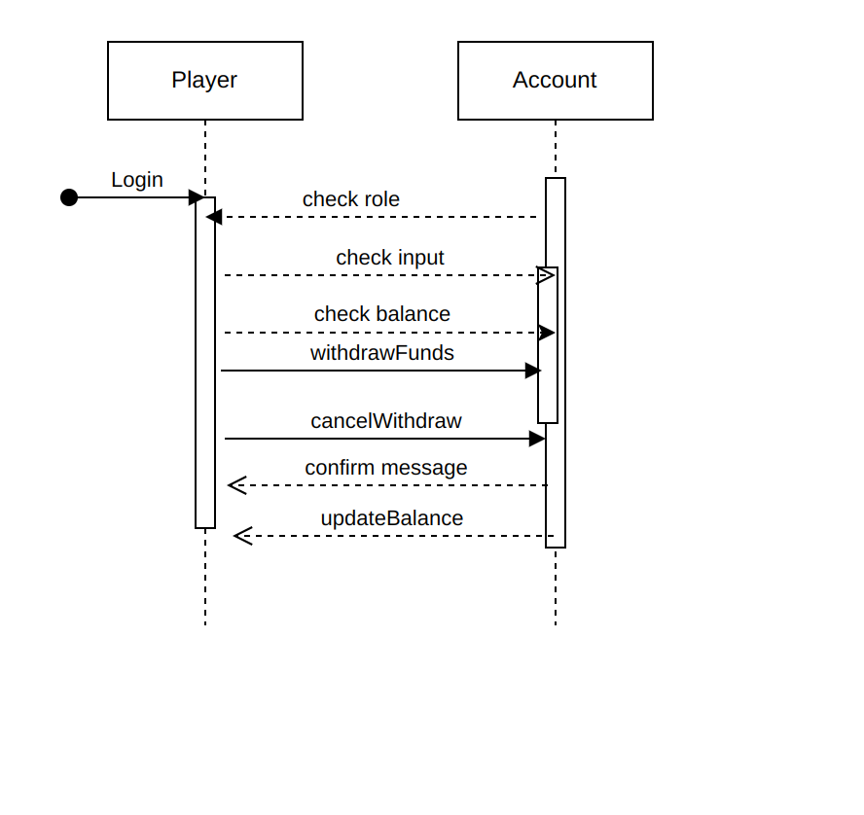
Sequence Diagrams of Use Cases:
Add Funds, Withdraw Funds

Slide 9
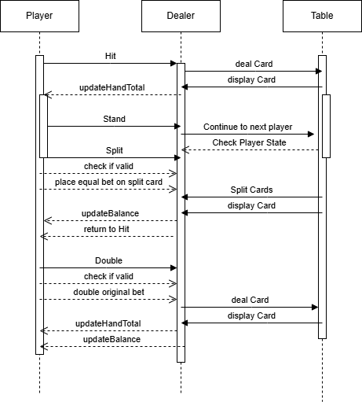
Sequence Diagrams of Use Cases:
Manage Hand
Player plays until win / loss condition is met.
Player can choose to Hit, Stand, Split, or Double Down.
Hitting will request the dealer to deal a card
Stand will end the turn
Split will create another hand
Double Down calls a Hit, then ends turn
Hand Totals are updated after every new card
After a win / loss condition is met:
Game will check for another hand and continue
If not, the turn will end, player state will update after a turn.
Balances are updated, Player awaits until round is over to play again

Slide 10
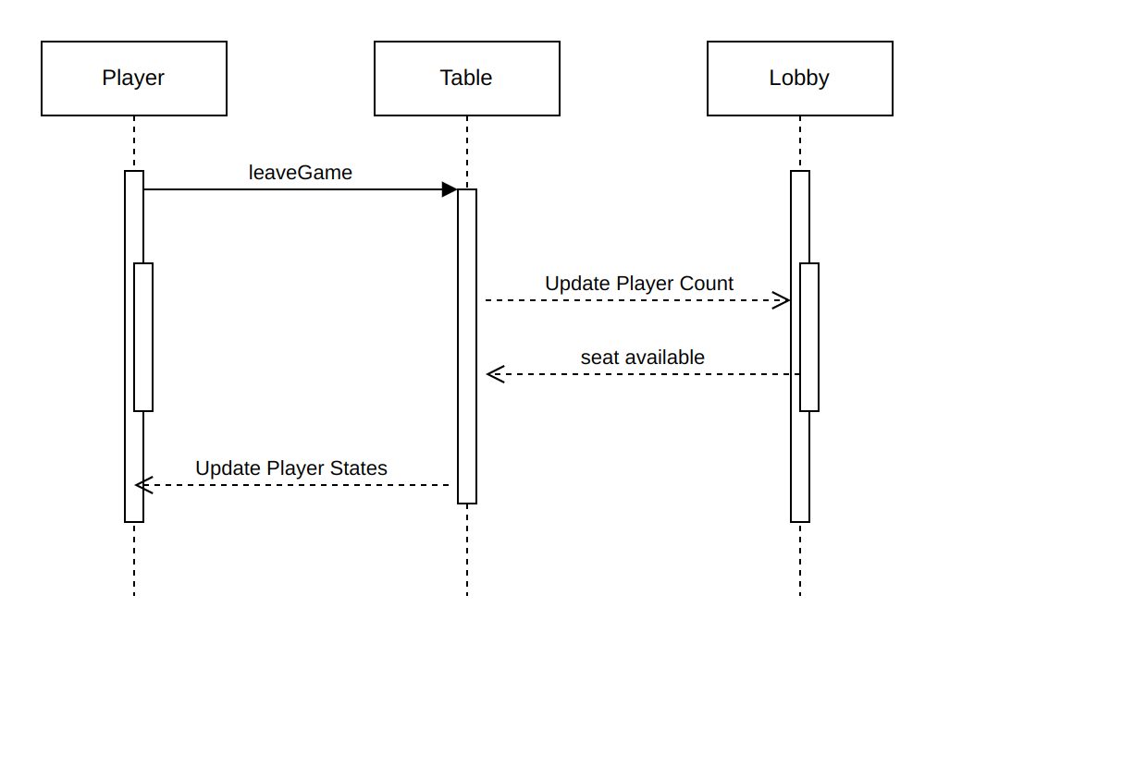
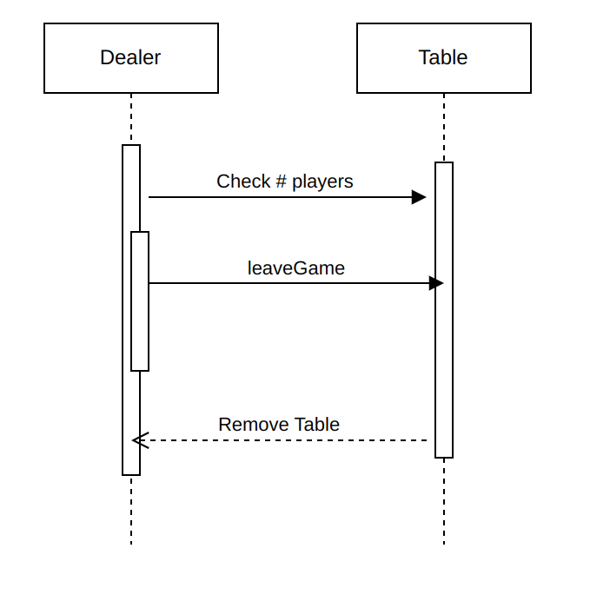
Sequence Diagrams of Use Cases:
Leave Game

Slide 11
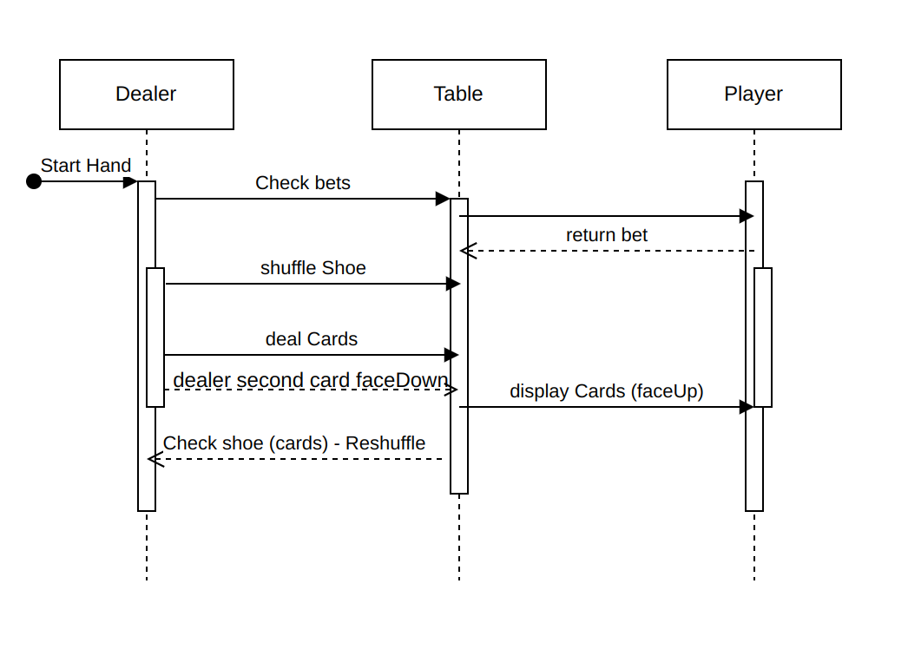
Sequence Diagrams of Use Cases:
Deal Cards

